Slide 1
City Pension Contributions and Trust Forecast
City Council Meeting
July 18, 2023

Slide 2
City Annual Required Contribution to CalPERS
Total Employer Contribution = Normal Cost + Unfunded Accrued Liability (UAL)
City staff contributes to the City’s (employer) contribution under cost sharing agreements
City contributions expected to increase annually through FY 2034/35, then expected to decrease through FY 2049/50

Slide 3
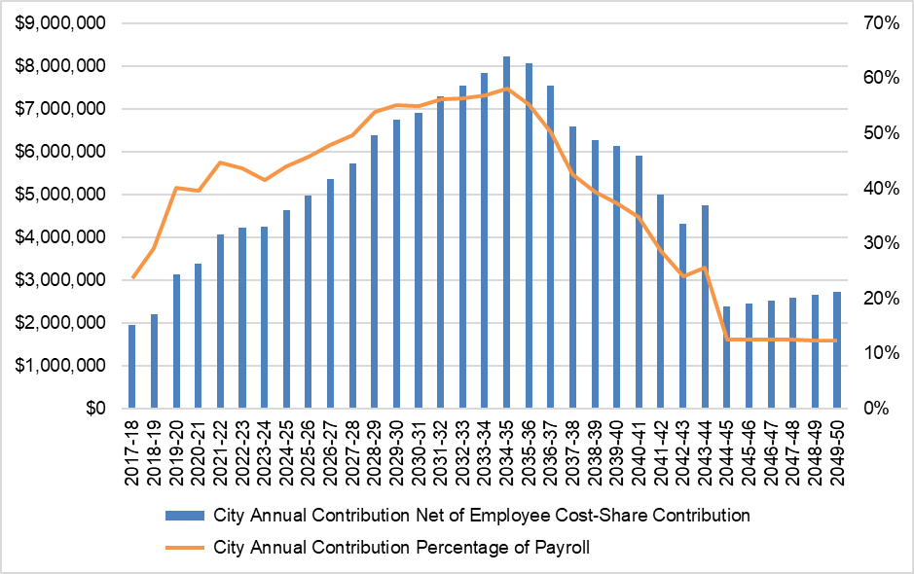
City Annual Required Contribution to CalPERS

Slide 4
Total Pension Costs
Total pension costs consists of the annual required contribution (net of employee cost-share) and pension obligation bond debt service
General Fund costs partially offset by the transfer from the Section 115 Trust
Total pension costs expected to decrease after pension obligation bonds are fully paid and retired in FY 2035/36

Slide 5
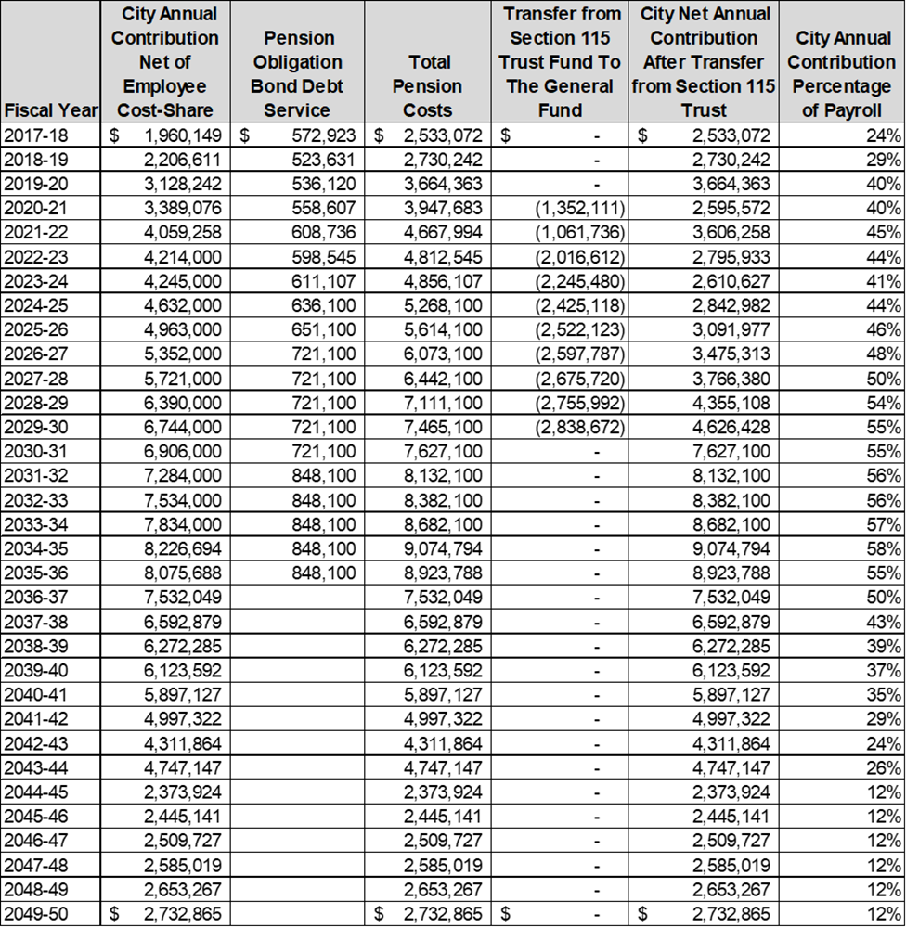
Total Pension Costs

Slide 6
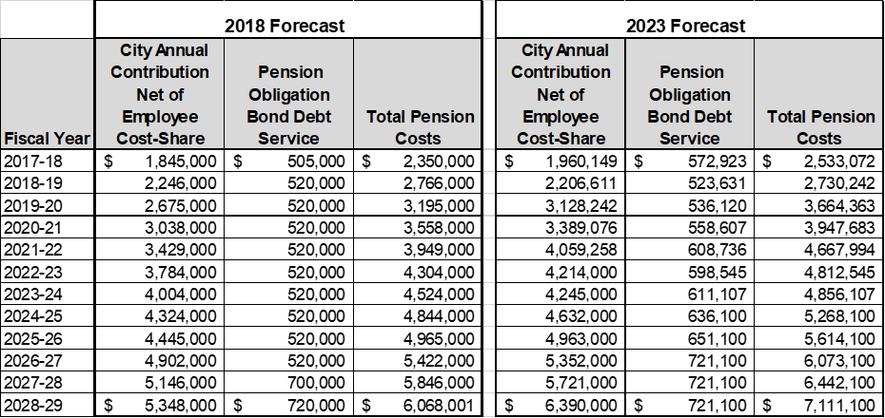
Comparison of Total Pension Costs

Slide 7
Section 115 Trust Fund
Established in 2018 to offset increases in the City’s annual required contribution to CalPERS
The funds can only be used to transfer directly to CalPERS or to reimburse the City for contributions made to CalPERS
Amount transferred from the Trust Fund is determined by calculating the difference between the required annual contribution for a given year and that from FY 2018/19, the baseline year
Trust Fund is estimated to last through FY 2029/30 after which the City will need to fund the full amount of the annual required contribution

Slide 8
Lifespan of Section 115 Trust Fund

Slide 9
Thank You
Questions and Comments?

